Slide 1


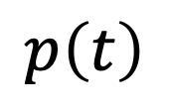


Iwasa et al.
Fig. 1
heat stress
$$h\left(t\right)$$
BVOC
production
photosynthesis
$$s\left(t\right)$$
$$λ\left(t\right)$$
$$p\left(t\right)$$
$$b\left(t\right)$$
effectiveness

Slide 2
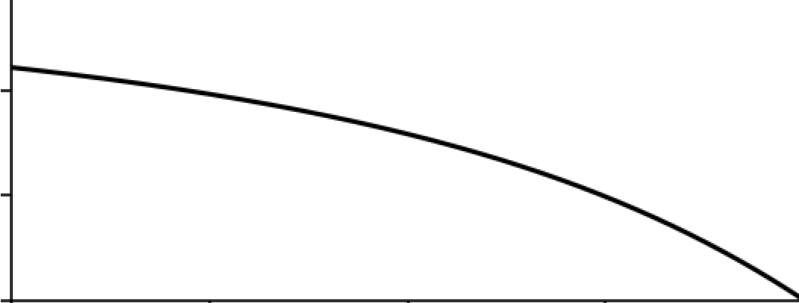
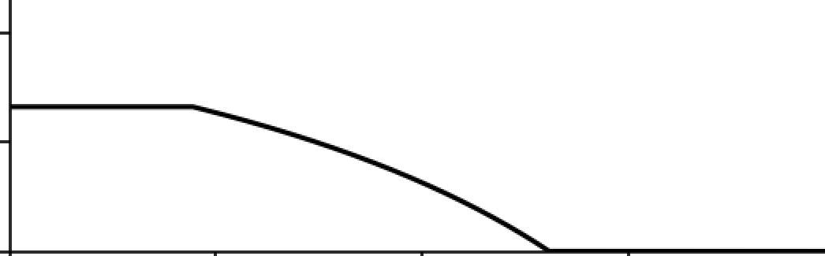











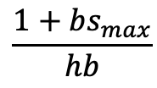








Iwasa et al.
Fig. 2
$$\frac{1+bs_{max}}{hb}$$
marginal value
of leaf area
$$λ\left(t\right)$$
$$0.4$$
$$λ\left(t\right)$$
$$\frac{1}{hb}$$
$$0.2$$
$$λ\left(t\right)$$
$$0$$
$$t_{f}$$
$$0$$
$$t$$
$$t_{s}$$
$$T$$
$$0.2$$
$$s_{max}$$
investment in
BVOC production
$$0.1$$
$$s\left(t\right)$$
$$0$$
$$t_{f}$$
$$t_{s}$$
$$0$$
$$t$$
$$T$$

Slide 3
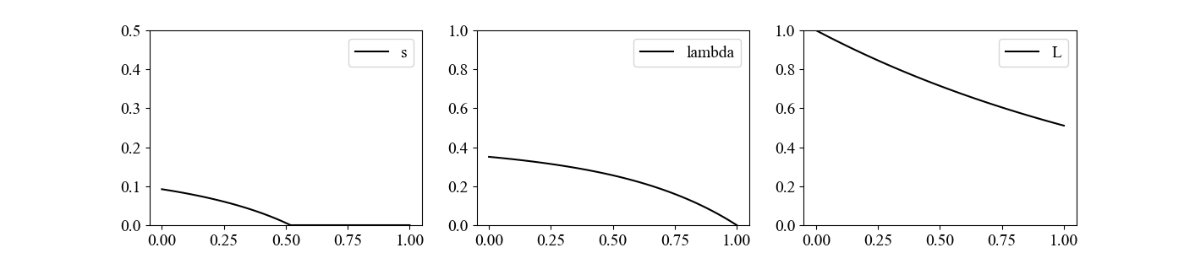
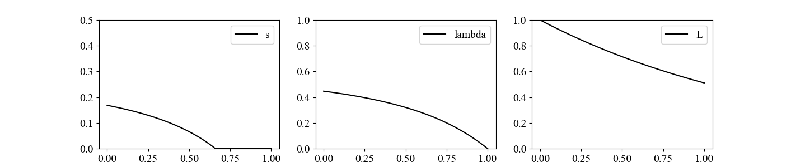
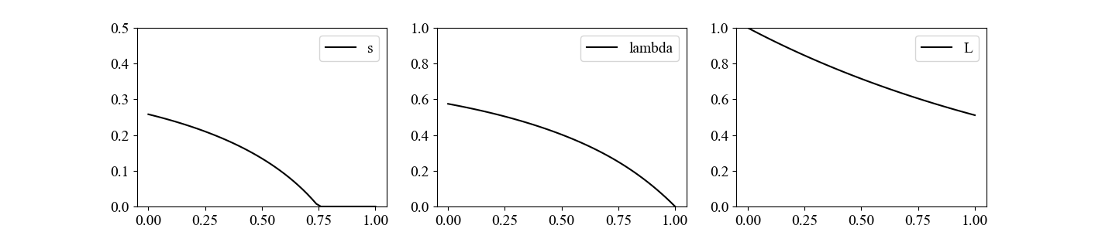














Iwasa et al.
Fig. 3(a)(b)(c)
(a)
(b)
(c)
$$s\left(t\right)$$
$$p=0.8$$
$$s\left(t\right)$$
$$h=1.6$$
$$s\left(t\right)$$
$$b=1.6$$
$$p=1$$
$$h=2$$
$$b=2$$
BVOC production
$$p=1.25$$
$$h=2.5$$
$$b=2.5$$
time
$$t$$
time
$$t$$
time
$$t$$

Slide 4










Iwasa et al.
Fig. 3(d)(e)
(d)
(e)
(c)
$$s\left(t\right)$$
$$u=0.00008$$
$$s\left(t\right)$$
$$h=1.6$$
$$b=1.6$$
$$T=1$$
$$u=0.0001$$
$$T=0.8$$
$$b=2$$
$$h=2$$
BVOC production
$$u=0.00012$$
$$T=0.6$$
$$h=2.5$$
$$b=2.5$$
time
$$t$$
time
$$t$$

Slide 5
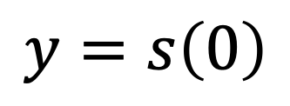

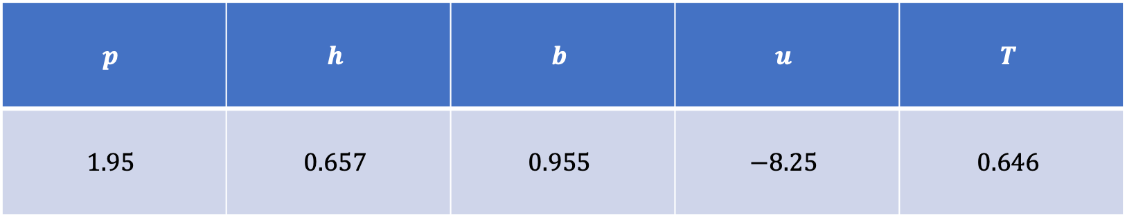
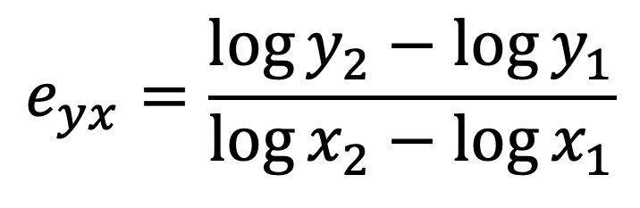
effect of enhanced $x$ on the change in
$$y=s\left(0\right)$$
$$e_{yx}=\frac{\log{y_{2}}−\log{y_{1}}}{\log{x_{2}}−\log{x_{1}}}$$
elasticity
$$p$$ | $$h$$ | $$b$$ | $$u$$ | $$T$$
$$1.95$$ | $$0.657$$ | $$0.955$$ | $$−8.25$$ | $$0.646$$
求め方
large
positive
small
positive
positive
close to
zero

Slide 6

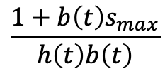






















Iwasa et al.
Fig. 4
heat stress
h$\left(t\right)$
$$0$$
$$\frac{1+b\left(t\right)s_{max}}{h\left(t\right)b\left(t\right)}$$
marginal value
of leaf area
$$\frac{1}{h\left(t\right)b\left(t\right)}$$
$$λ\left(t\right)$$
$$λ\left(t\right)$$
$$λ\left(t\right)$$
$$0$$
$$t_{f}$$
$$t_{s1}$$
$$t_{f1}$$
$$t_{f2}$$
$$t_{s2}$$
$$T$$
$$s_{max}$$
BVOC
production
$$s\left(t\right)$$
$$0$$
$$0$$
$$t_{s1}$$
$$t_{f1}$$
$$t$$
$$t_{f2}$$
$$t_{s2}$$
$$T$$

Slide 7
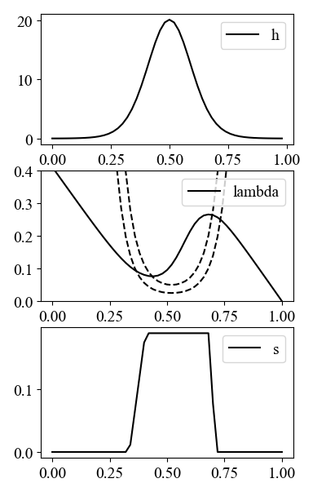
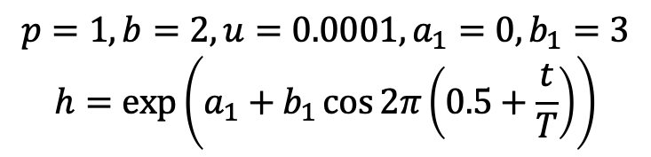
Iwasa et al.
Fig. 4
heat stress
marginal value
of leaf area
$$p=1, b=2, u=0.0001,a_{1}=0, b_{1}=3$$
$$h=\exp\left(a_{1}+b_{1}\cos{2π}\left(0.5+\frac{t}{T}\right)\right)$$
BVOC
production

Slide 8
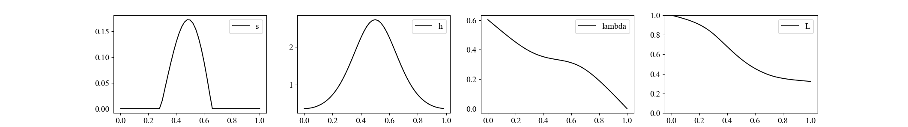
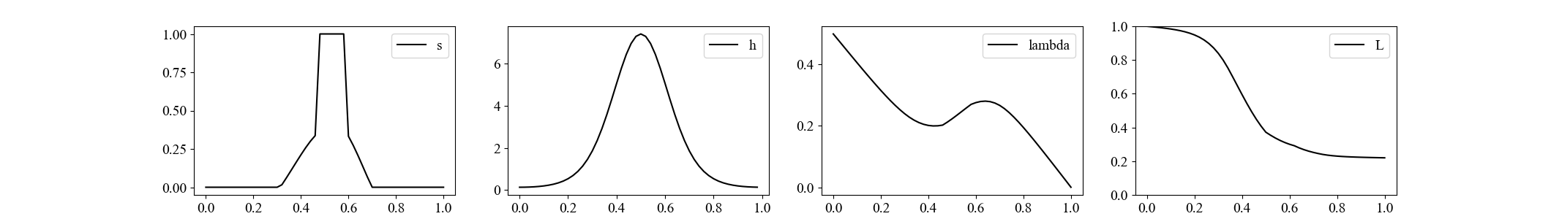
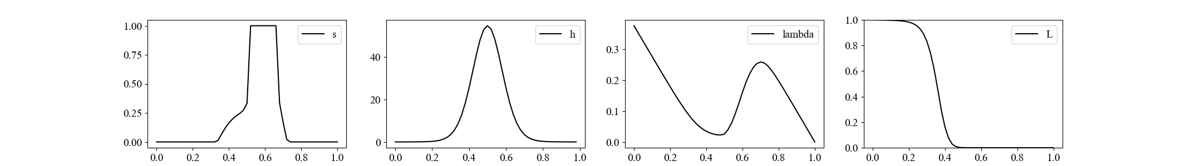



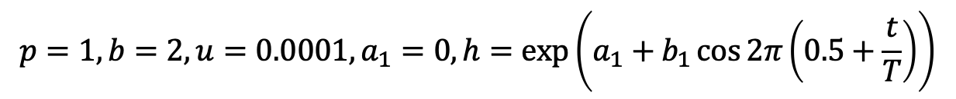


$$p=1, b=2, u=0.0001,a_{1}=0,h=\exp\left(a_{1}+b_{1}\cos{2π}\left(0.5+\frac{t}{T}\right)\right)$$
Iwasa et al.
Fig. 5
BVOC production
heat stress
marginal value
leaf area
$${ b}_{1}=1$$
$$b_{1}=2$$
$$b_{1}=4$$
$$t$$
$$t$$
$$t$$
$$t$$

Slide 9
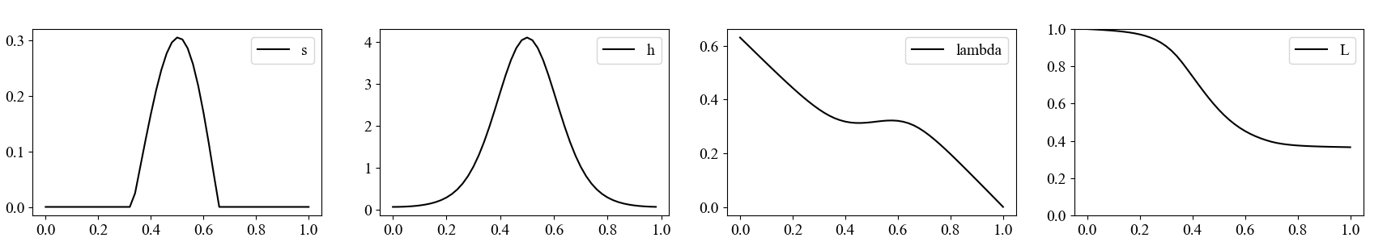
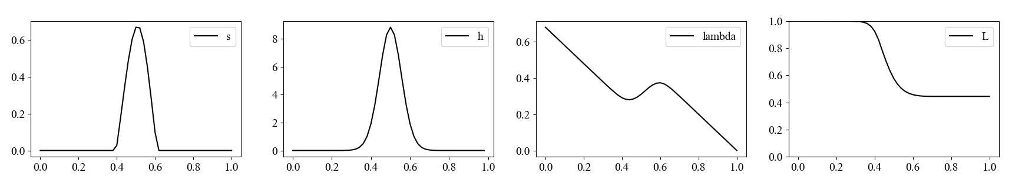

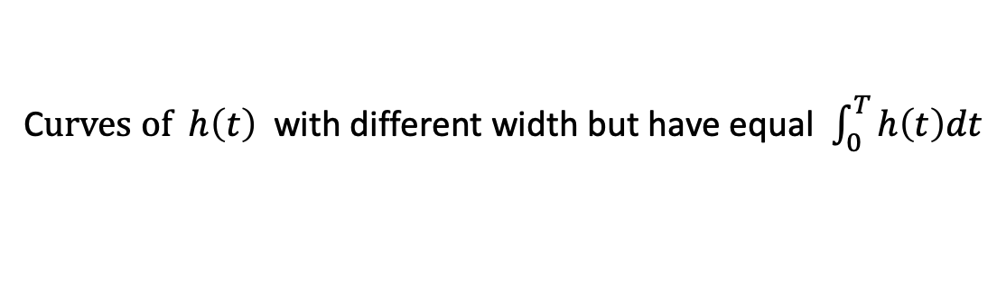










C$urves of h\left(t\right)$ with different width but have equal $\int_{0}^{T}{h\left(t\right)dt}$
Iwasa et al.
Fig. 6
$p=1, b=2, u=0.0001$, $h=\exp\left(a_{1}+b_{1}\cos{2π}\left(0.5+\frac{t}{T}\right)\right)$
BVOC production
heat stress
marginal value
leaf area
$$s\left(t\right)$$
$$h\left(t\right)$$
$$λ\left(t\right)$$
$$L\left(t\right)$$
$$a_{1}=0,$$
$${ b}_{1}=1$$
$$a_{1}=−0.588,$$
$${ b}_{1}=2$$
$$a_{1}=−5.822,$$
$${ b}_{1}=8$$
$$t$$
$$t$$
$$t$$
$$t$$

Slide 10
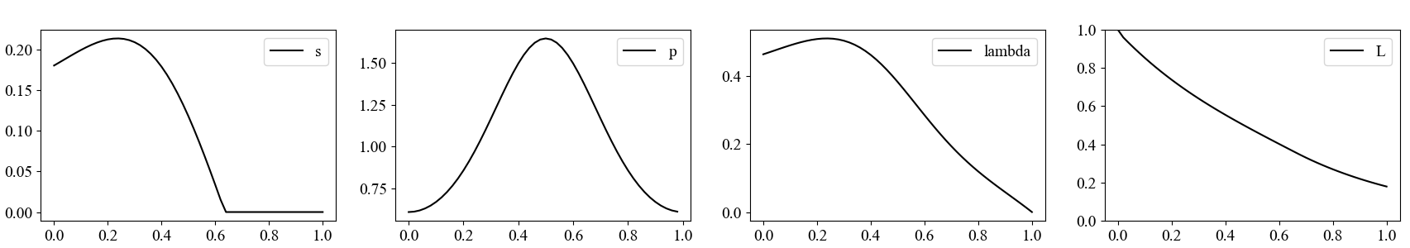





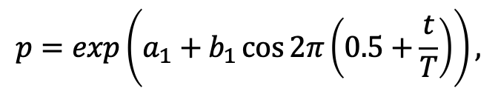




Iwasa et al.
Fig. 7
$$p=\exp\left(a_{1}+b_{1}\cos{2π}\left(0.5+\frac{t}{T}\right)\right),$$
$$h=2, b=2, u=0.0001,$$
$$a_{1}=0, { b}_{1}=0.5$$
BVOC production
Photosynthesis
marginal value
leaf area
$$s\left(t\right)$$
$$p\left(t\right)$$
$$λ\left(t\right)$$
$$L\left(t\right)$$
$$t$$
$$t$$
$$t$$
$$t$$

Slide 11
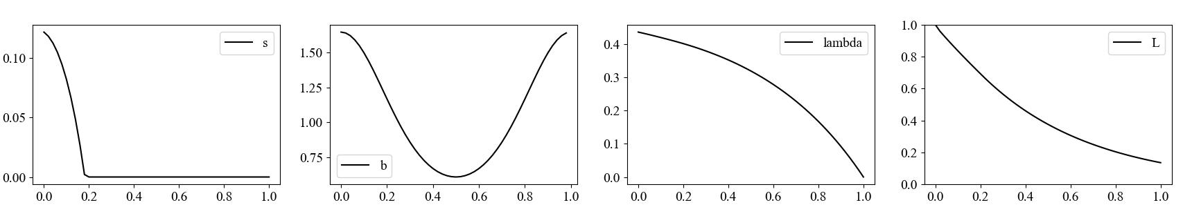





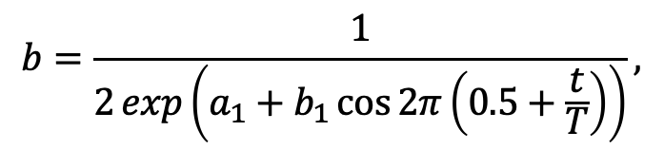




Iwasa et al.
Fig. 8
$$b=\frac{1}{2\exp\left(a_{1}+b_{1}\cos{2π}\left(0.5+\frac{t}{T}\right)\right)},$$
$$p=1, h=2, u=0.0001,$$
$$a_{1}=0, { b}_{1}=−0.5$$
BVOC production
Photosynthesis
marginal value
leaf area
$$s\left(t\right)$$
$$b\left(t\right)$$
$$λ\left(t\right)$$
$$L\left(t\right)$$
$$t$$
$$t$$
$$t$$
$$t$$
BVOC production
stops in summer
leaf area is lost
rapidly in autumn

Slide 12
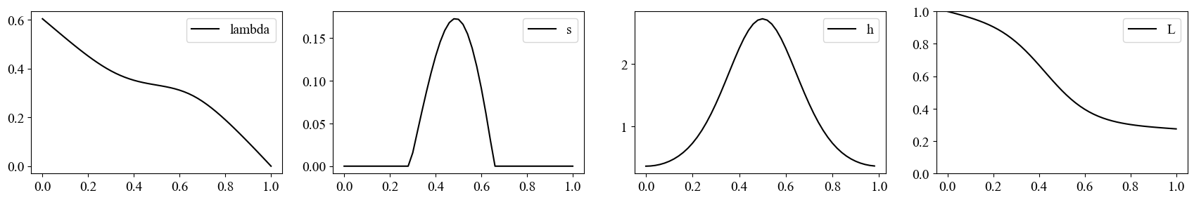
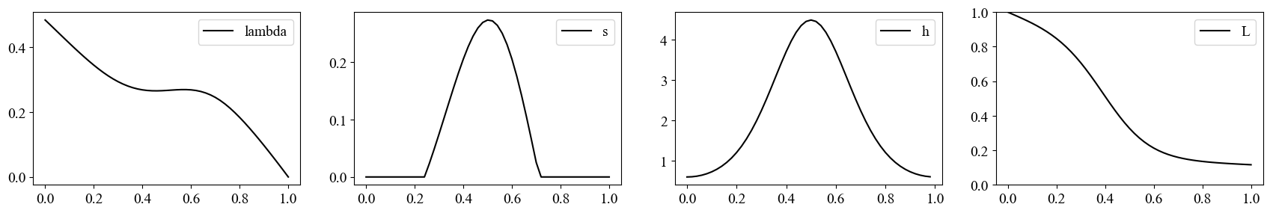
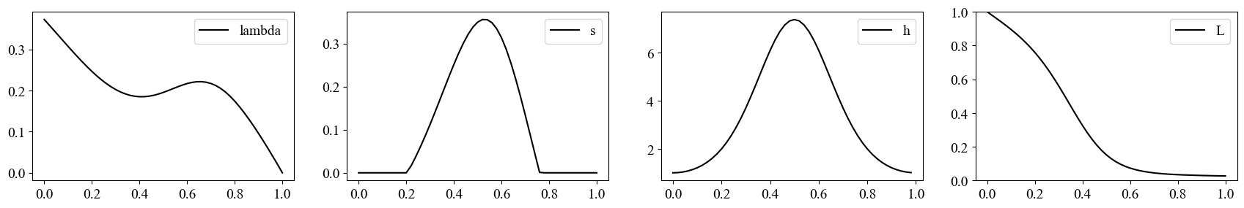




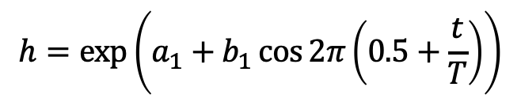

Change in the magnitude of heat stress
with keeping the same shape
$$p=1, a=2, u=0.0001, k=1,$$
Iwasa et al.
Fig. 5
$$h=\exp\left(a_{1}+b_{1}\cos{2π}\left(0.5+\frac{t}{T}\right)\right)$$
$$b_{1}=1$$
marginal value
BVOC production
heat stress
leaf area
$$a_{1}=0$$
$$a_{1}=0.5$$
$$a_{1}=1$$
Marginal value of leaf area is higher after the peak heat stress

Slide 13
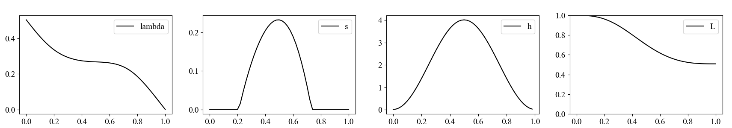
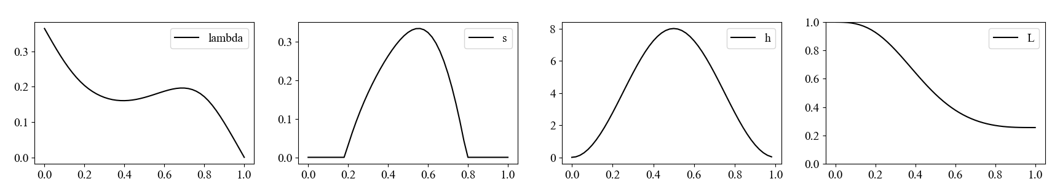




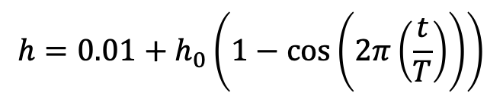







$$p=1, h=2, a/k=2, u=0.0001,$$
Iwasa et al.
Fig. 8
$$h=0.01+h_{0}\left(1−\cos\left(2π\left(\frac{t}{T}\right)\right)\right)$$
BVOC production
heat stress
$$h_{0}=2$$
$$λ\left(t\right)$$
$$s\left(t\right)$$
$$h\left(t\right)$$
$$L\left(t\right)$$
BVOC production
heat stress
$$h_{0}=4$$
$$λ\left(t\right)$$
$$s\left(t\right)$$
$$h\left(t\right)$$
$$L\left(t\right)$$
BVOC is produced only in the summer

Slide 14


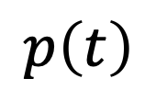


heat stress
$$h\left(t\right)$$
photosynthesis
BVOC production
$$p\left(t\right)$$
$$λ\left(t\right)$$
$$s\left(t\right)$$
$$b\left(t\right)$$
effectiveness

